Slide 1
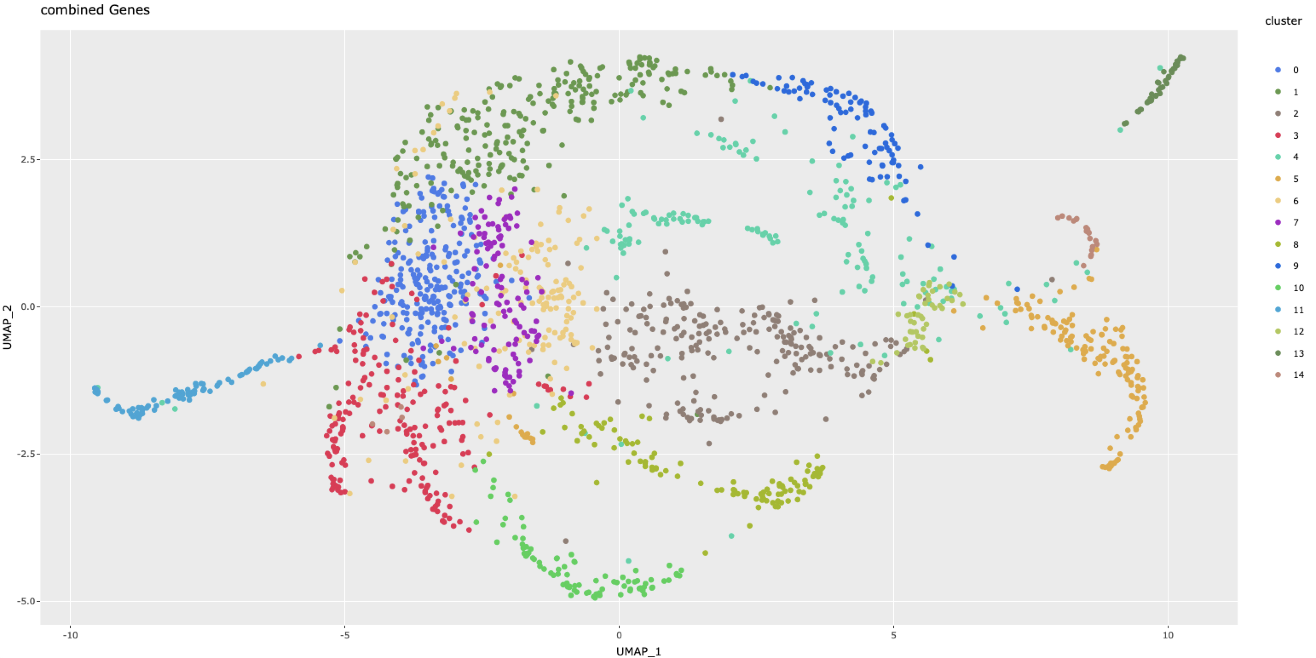
13 Proliferation genes
top2a, mki67, pcna, cdk1
1 Mature ENS genes
nos1, calb2a, satb2, dbh, nmu, gata3,
gfap
9 Developing and mature neuron genes
elavl3, elavl4, prph, gap43, phox2a, ret,
hand2,gfra1a, tph1b, vipb
her4.3, her4.3,
ascl1a, dla, dlb
6 Glia/Neuron genes
itgb4, s100b,
gfra1b, tac1
her4.1, her4.2, her2, eya1, her15.1
7 unassigned
mixed genes
4 Glia/Neurogenic genes
14 Xanthophore/Iridophore genes
pax7b, aox5, gch2, atic
foxd3, zeb2a,
fabp7a, scn4ab
0 Muscle/mixed
myf5, myoz1b, slc6a4a
plp1b,mpz
mbpa,
mbpb
2 Mesoderm genes
meox1, twist1a/2/3
sox10
11 Myogenic genes
myod1, myog, ckmb
12 Progenitor genes
fosab, fosl1a, her6, her9, id1,
3 unassigned
mixed genes
8 unassigned
mixed genes
5 Melanophore/Xanthophore genes
tyrp1b, pme1a, atic,
10 unassigned
mixed genes

Slide 2
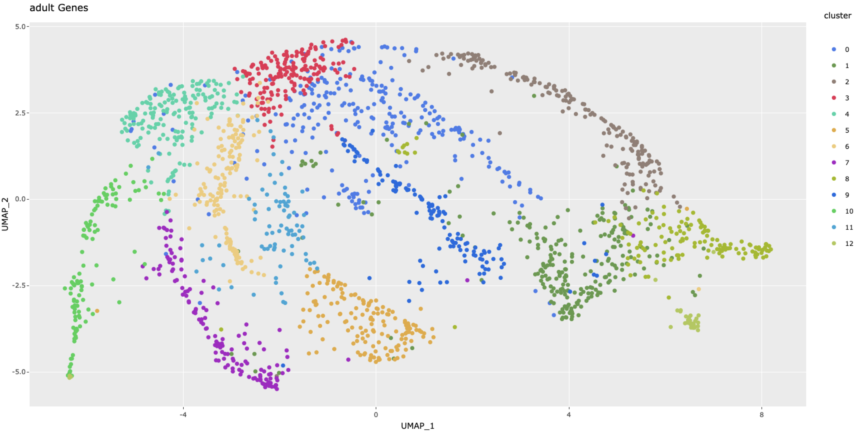
9 unassigned
mixed
3 unassigned
mixed genes
4 Notch signalling genes
her4.1, her4.2, her4.4, her4.5
her2, pax3a, pax7b,
2 Serotonergic genes
tph1b, bnc2, slc4a6a/b
satb2, myo16, ddc, gfra2
6 unassigned
mixed genes
0 Cholinergic genes
barx2, alk, vip, th, calb1
8 Nitrergic (& serotoergic) genes
nos1, tac1, ebf3a,
vipb, zeb1b, stat3
10 unassigned
mixed genes
11 Glia genes
mpz, foxd3,her9
12 Neural/ neural progenitor genes
hand2, gap43 tuba1a
1 Cholinergic genes
chata, nmu, pbx1a, myo3b,
acta2, eya1, grid1b, cpne7, ngfra
7 Epithelial genes
epcam, met, prox1a
5 Glia/Progenitor genes
sox10, klf4, scn4ab, zeb2a, fpsb,
yap1,her6, gfra1b, ncam1a/b, sorcs2

Slide 3
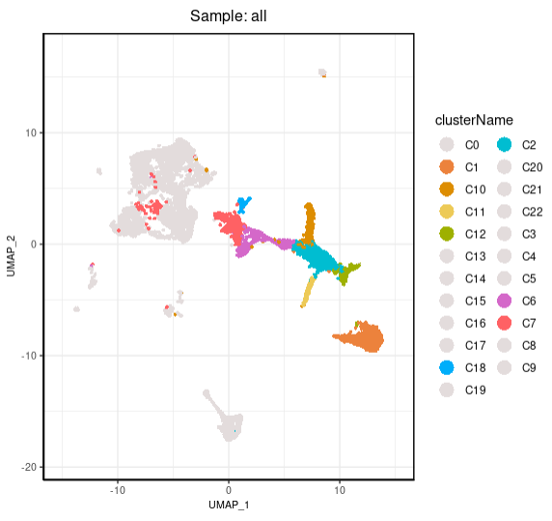
Three main trajectories with a common origin
Glia are situated at the origin, then give rise to neurons that are either:
NOS (Nitrergic)
5HT (Serotonergic)
ChAT (Cholinergic)
NOS
(Nitrergic)
Glia
progenitors
5HT
(Serotonergic)
ChAT
(Cholinergic)
Notes:
<number>

Slide 4
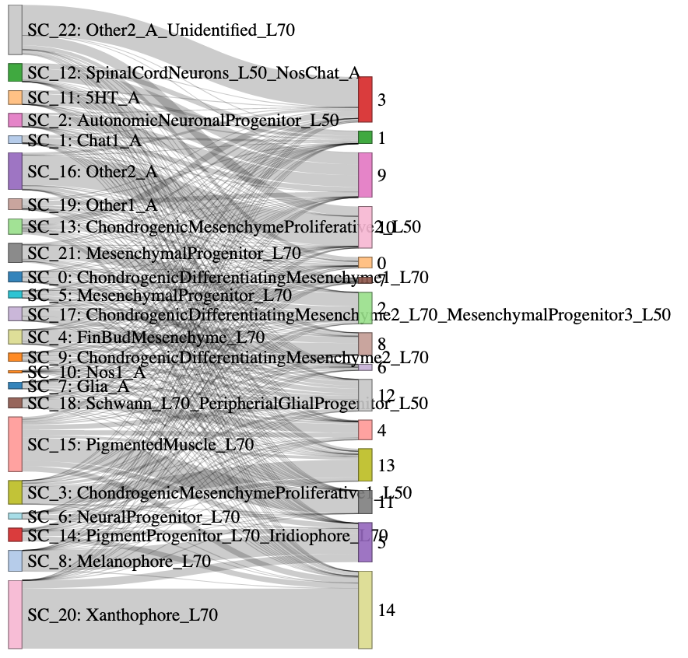
Cholinergic progenitor
Serotonergic neuron
Late Neural progenitor
Cholinergic neuron
NOS
(Nitrergic)
Glia
progenitors
Nitrergic neuron
5HT
(Serotonergic)
Glia/Progenitor
Schwann Cell
ChAT
(Cholinergic)
Neuronal progenitor

